Slide 1

Project Title -
Seasonal Agriculture Performance Analysis
Student Name –Pankaj Sharma
College Name-SMT.Chandibai Himatmal Mansukani College
AICTE STU ID : STU6a564b83a31ff1784040323

Slide 2

PROBLEM STATEMENT
Agricultural activities are influenced by seasonal variations in environmental conditions, farming practices, resource availability and market conditions. As a result, agricultural performance may differ from one season to another.
However, raw agricultural data does not clearly explain how agricultural performance changes across seasons or what patterns can be observed in different seasonal conditions.
The problem is to analyze the given agricultural dataset and investigate seasonal differences in agricultural performance by identifying meaningful patterns, trends, relationships and variations within the available data.

Slide 3
Project Description Agricultural Seasonal Performance Analysis is a data analysis project designed to study and evaluate agricultural production across different seasons. The project uses agricultural data such as type, season, cultivated area, production, and other relevant factors to identify seasonal patterns and variations in crop performance. The data is cleaned and analyzed using Python, Pandas, NumPy, Matplotlib, and Seaborn. Exploratory Data Analysis (EDA) is performed to understand the relationship between cultivated area and production and to compare agricultural performance across different seasons. The main objective of the project is to provide a clear understanding of seasonal agricultural performance and support better decision-making for crop planning, resource management, and productivity improvement.

Slide 4

WHO ARE THE END USERS?
Farmers – To understand which seasons and crops provide better production.
Agricultural Planners – To plan crop cultivation and allocate resources effectively.
Government Agricultural Departments – To develop agricultural policies and support programs.
Agricultural Researchers – To study seasonal trends and productivity.
Agribusiness Companies – To understand production trends for supply and market planning.
Agricultural Consultants – To provide data-based recommendations to farmers.
Primary end user: Farmers and agricultural planners, because they can use the analysis to make better decisions about crop selection, cultivation, and resource management.

Slide 5

Technology Used
Python – Main programming language for data analysis.
Pandas – Data cleaning, manipulation, and analysis.
NumPy – Numerical calculations and data processing.
Matplotlib – Creating charts and graphs.
Seaborn – Creating statistical visualizations.
Jupyter Notebook – Environment used to write and execute Python code.
CSV Dataset – Used to store and analyze agricultural data.
Main Technology Stack: Python + Pandas + NumPy + Matplotlib + Seaborn

Slide 6
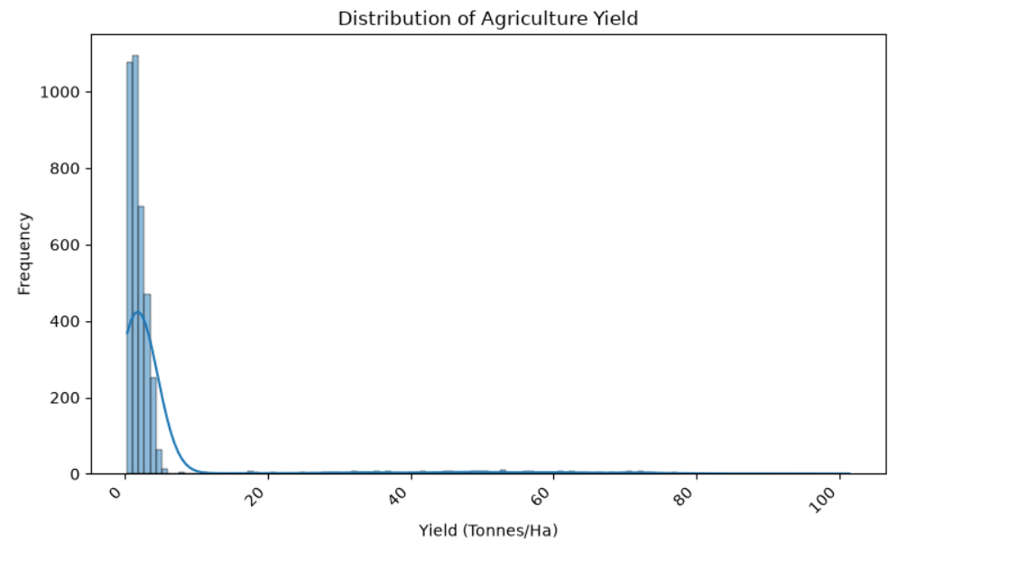
RESULTS

Slide 7
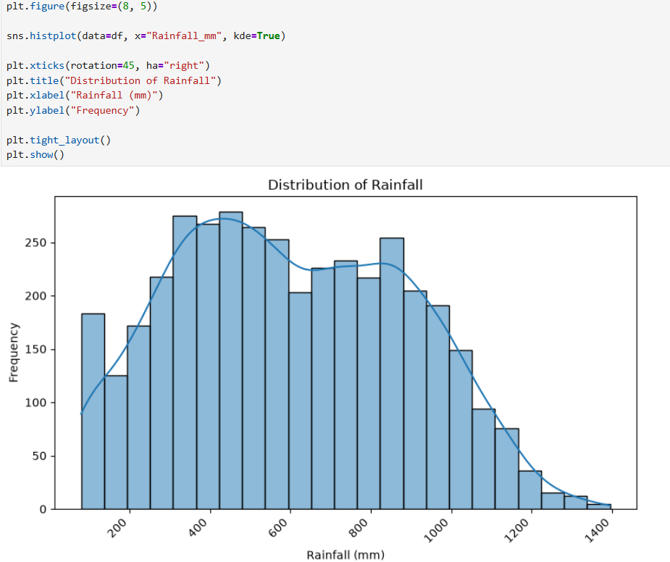
RESULTS
[Add screen shots of your code ]

Slide 8
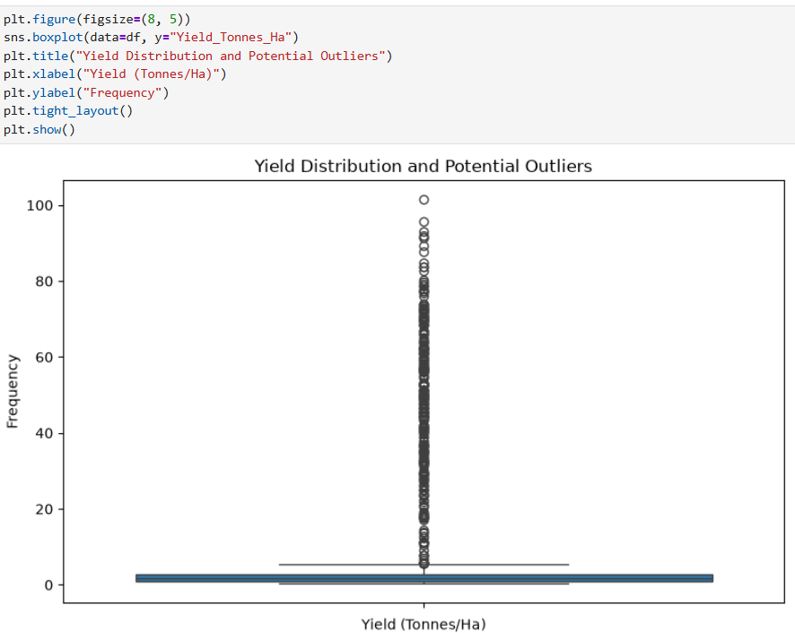
RESULTS
[Add screen shots of your code ]

Slide 9
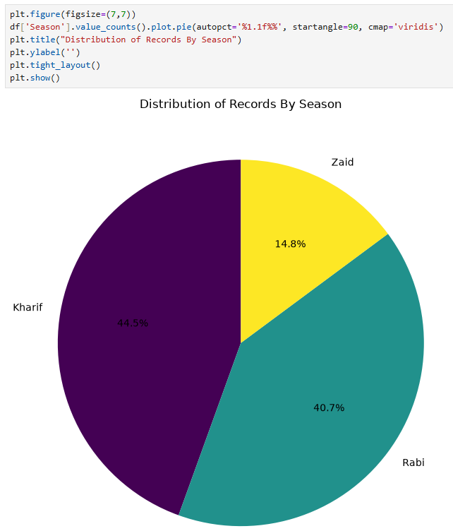
RESULTS
[Add screen shots of your code ]

Slide 10
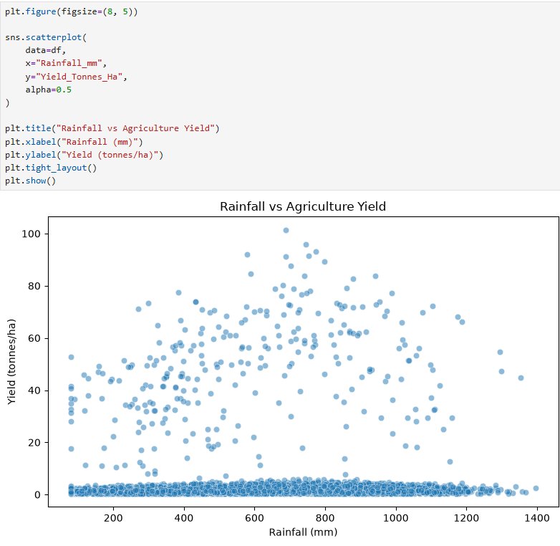
RESULTS
[Add screen shots of your code ]

Slide 11
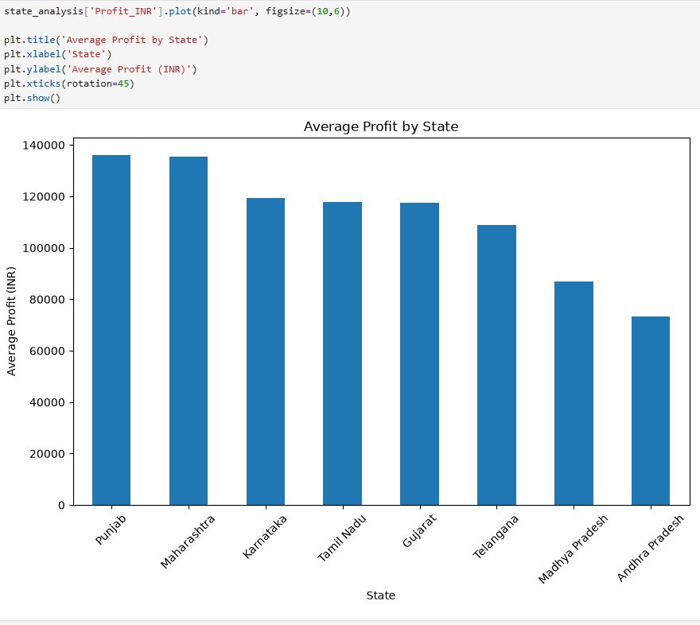
RESULTS
[Add screen shots of your code ]

Slide 12
Future scope
Crop Yield Prediction – Machine learning can be used to predict future crop production based on historical data.
Weather Integration – Weather data such as rainfall, temperature, and humidity can be included to improve the analysis.
Real-Time Data Analysis – Real-time agricultural and weather data can be used to monitor crop performance continuously.
Crop Recommendation – The system can recommend suitable crops for a particular season based on historical performance and environmental conditions.
Interactive Dashboard – A Power BI or Streamlit dashboard can be developed for easier visualization and decision-making.
Soil Data Integration – Soil type, moisture, and nutrient information can be added to understand their effect on crop productivity.
AI-Based Decision Support – Artificial intelligence can provide data-driven suggestions for improving agricultural productivity.
Mobile Application – The project can be extended into a mobile app so farmers can easily access seasonal agricultural insights.

Slide 13
GitHub Link
https://github.com/panksssssss/Seasional-Agriculture-performamnce-analysis-

Slide 14
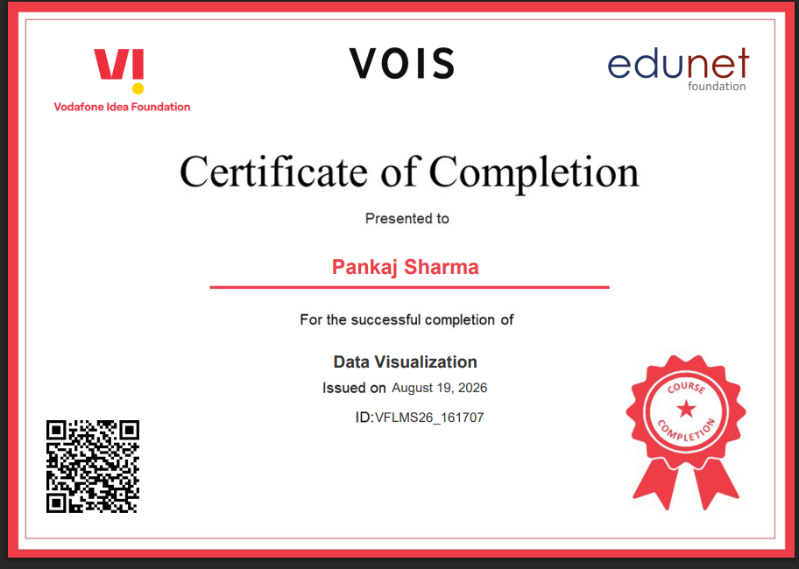
VOIS Course completion certificate - Course name- Data Visualization

Slide 15
Thank you
Pankaj Sharma
.
.

